Slide 1

Data Encryption and Transmission Based on ESP32 Boards
Group members:
Jialun KOU
Han BAO
Andi SULA

Slide 2
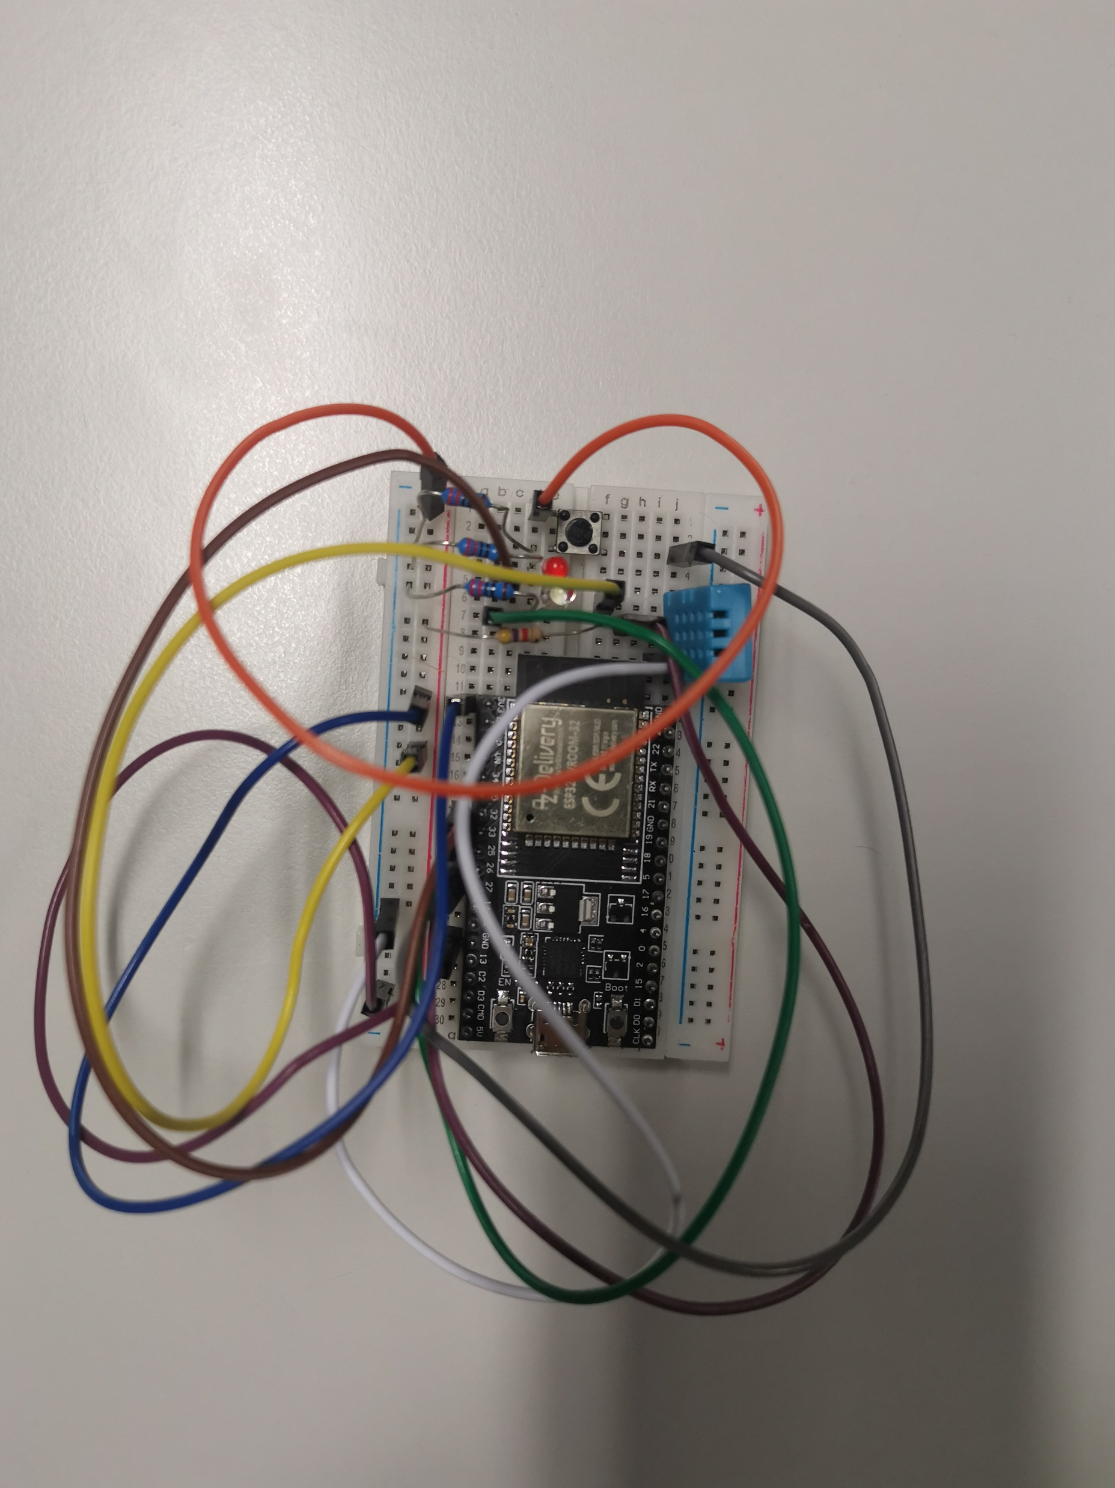
Schematic
Button
DH 11 Sensor
ESP-32

Slide 3
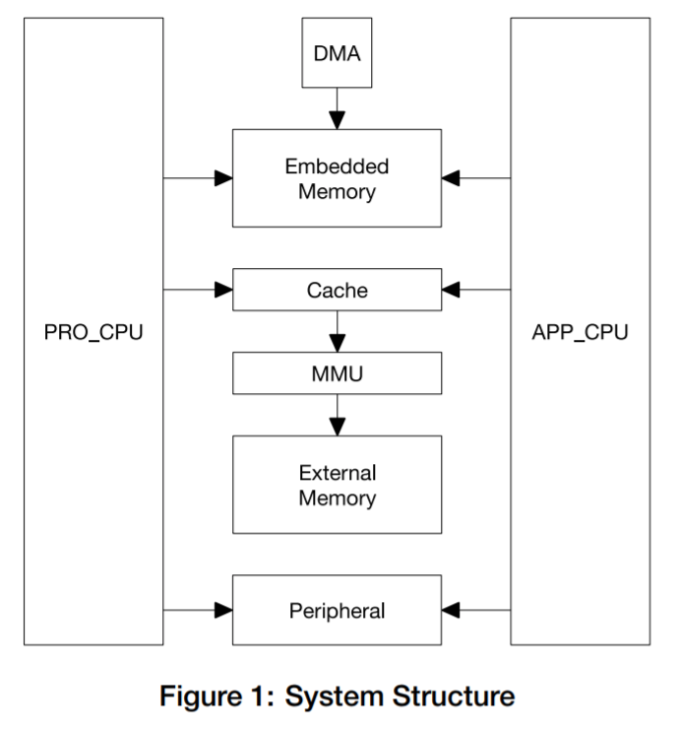

ESP32 Block Diagram
(example of SMP architecture)
Structure
32 KB
32 KB
Core 0 Cache
Core 1 Cache
0
1
Task A
Scheduler
Scheduler
(diagram is from the ESP32 Technical Reference Manual)

Slide 4
From Single Core to Dual Core
Core
Core0
Core1
WIFI
MQTT
Sensor
Sensor
WIFI
MQTT

Slide 5
Queue of Dual Core
Queue
。。。。。。。
Core 0
Core 1
Serial Monitor

Slide 6
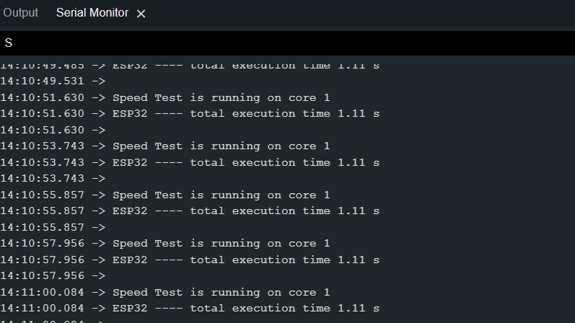
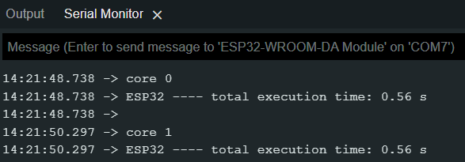
Compare between Single Core and Dual Core

Slide 7
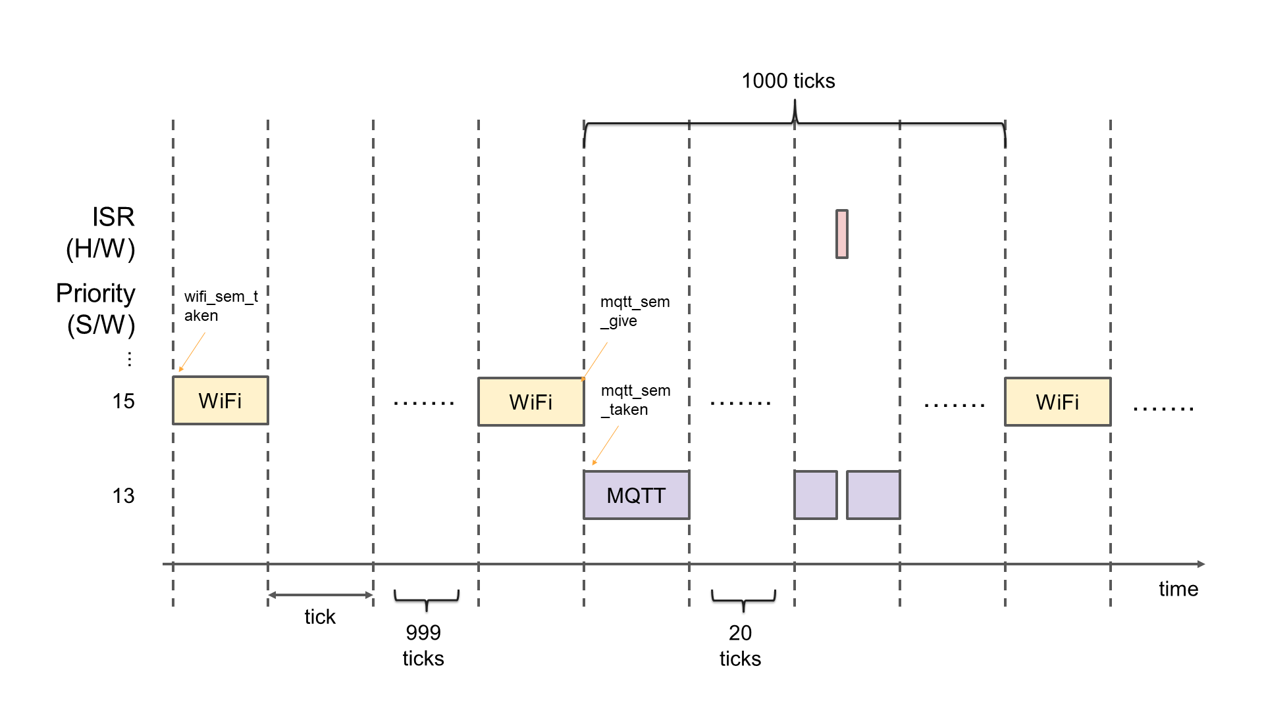
Multi-task scheduling

Slide 8
Data encryption
Temperature
2 bytes
Humidity
2 bytes
Sensor
Plain Text
4 bytes
Temperature
2 bytes
Humidity
2 bytes
Padding
Padded Plain Text
16 bytes
Temperature
2 bytes
Humidity
2 bytes
0C 0C 0C 0C 0C 0C 0C 0C 0C 0C 0C 0C
0C × 12

Slide 9
Data encryption
Padded Plain Text
16 bytes
16 bytes AES Key
HMAC
Key
Authentication Data
32 bytes
AES Cipher
16 bytes
AES Cipher
16 bytes
Hash
Algorithm
Integrity Data
32 bytes
Length of AES Cipher
1 byte
AES Cipher
16 bytes
Authentication Data
32 bytes
Integrity Data
32 bytes
Final Ciphered Data

Slide 10
Data decryption
AES Cipher
16 bytes
Authentication Data
32 bytes
Integrity Data
32 bytes
Divide According to the Last byte
i.e first 16 bytes
From
16 to
16 + 31
From
16 + 32 to
16 + 63
Length of AES Cipher
1 byte
(Assume 16 here)
AES Cipher
16 bytes
Authentication Data
32 bytes
Integrity Data
32 bytes
Authentication Check
Integrity Check
PASS
PASS
AES Cipher
16 bytes
16 bytes
AES key
Plain Text
4 bytes
Temperature
2 bytes
Humidity
2 bytes
Unpadding

Slide 11
Data transmission and receiving
Send to Node-Red and plot
Topic A: ESP32-A: Humidity & Temperature
Topic B: ESP32-B: Humidity & Temperature
Server
ESP32-A: Humidity & Temperature
ESP32-B: Humidity & Temperature
ESP32-A: Humidity & Temperature
ESP32-B: Humidity & Temperature
ESP32-A
ESP32-B

Slide 12
Encrypted data transmission and receiving
Topic A: ESP32-A Encrypted Data
Topic B: ESP32-B Encrypted Data
Server
ESP32-B Encrypted Data
ESP32-A Encrypted Data
ESP32-A Encrypted Data
ESP32-B Encrypted Data
ESP32-A
ESP32-B

Slide 13
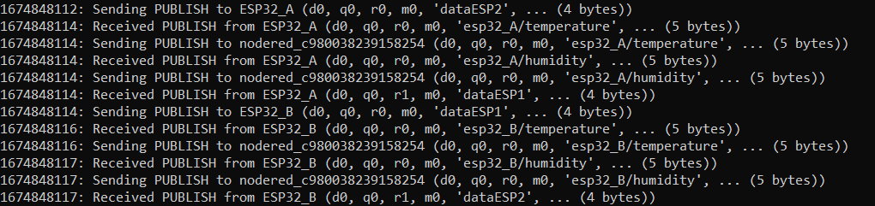
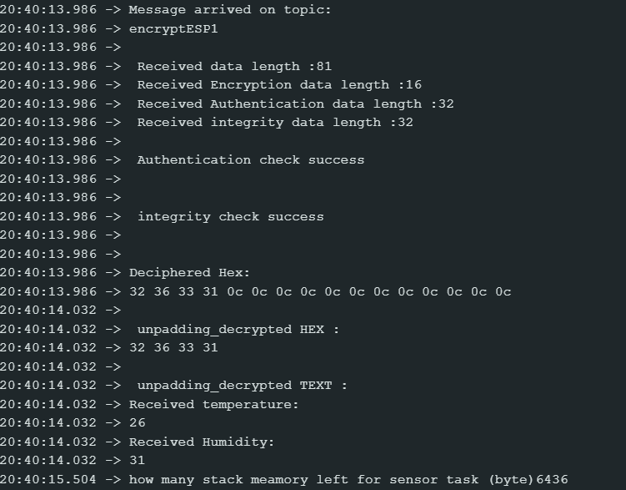

Result
Un-encrypted data seen from MQTT
Encrypted data seen from MQTT
Data encryption

Slide 14
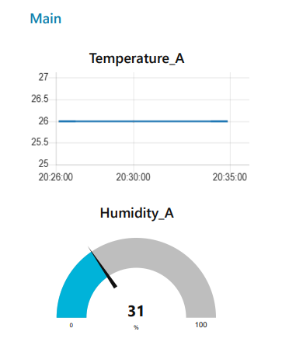
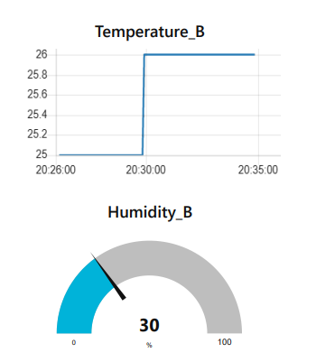
Result

Slide 15
Thank you for listening

